Slide 1
Exploiting Virtual Array Diversity for Accurate Radar Detection
Junfeng Guan★† Sohrab Madani★ Waleed Ahmed★ Samah Hussein†
Saurabh Gupta★ Haitham Hassanieh★†
★ University of Illinois Urbana-Champaign (UIUC), USA
† École Polytechnique Fédérale de Lausanne (EPFL), Switzerland

Slide 2
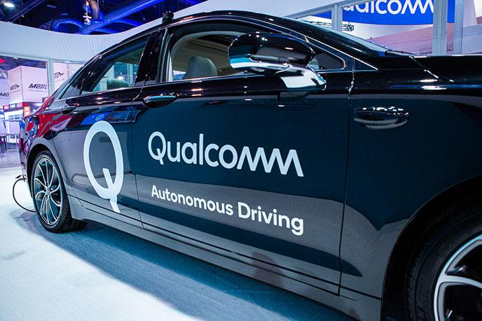
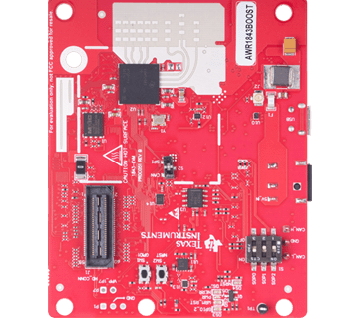
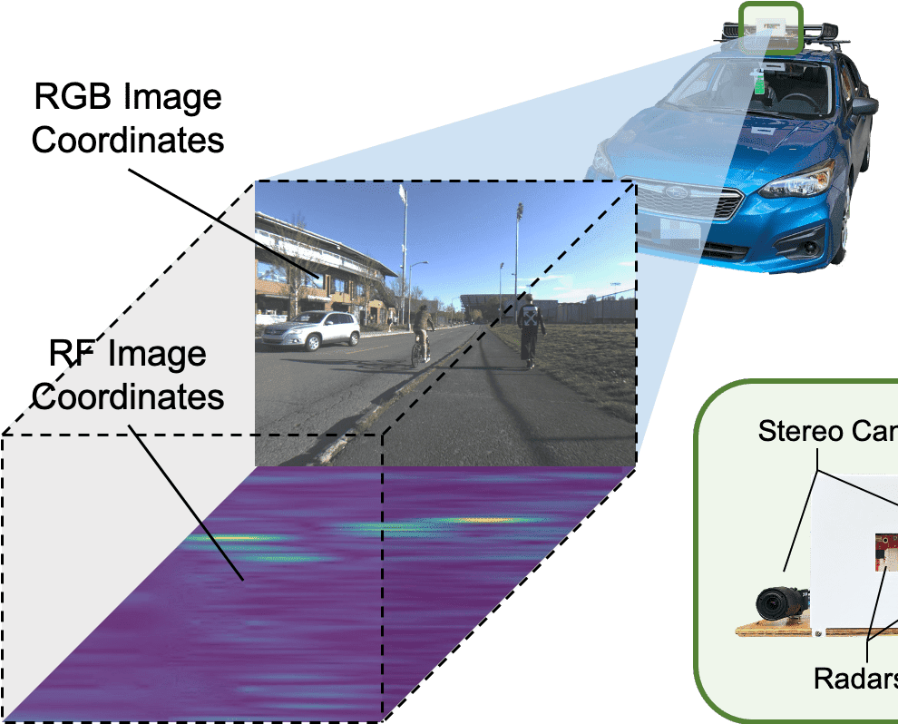
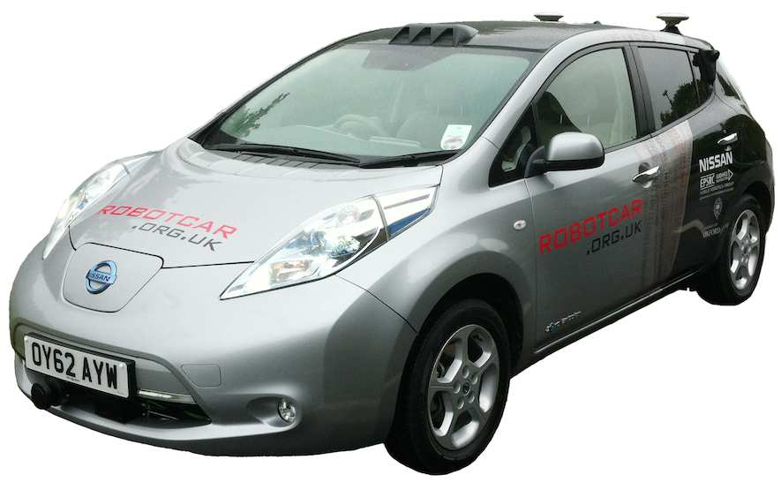
Millimeter Wave Radar
Millimeter Wave Radar
Waymo
Univ. of Washington CRUW
KAIST K-Radar
Oxford RobotCar

Slide 3
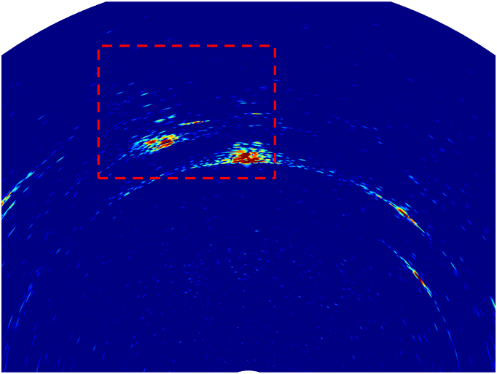
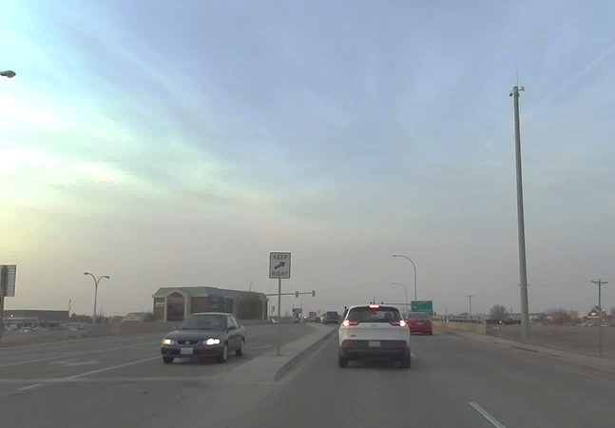
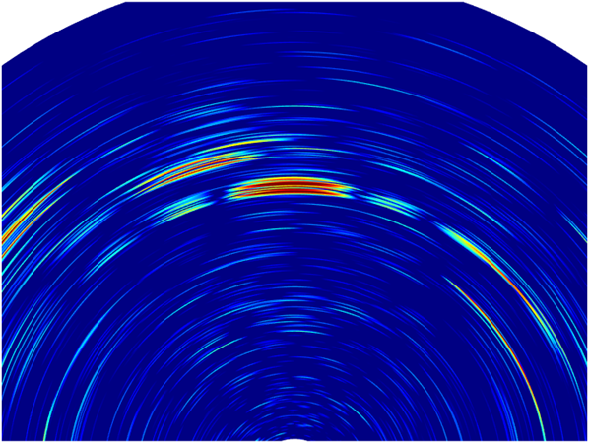
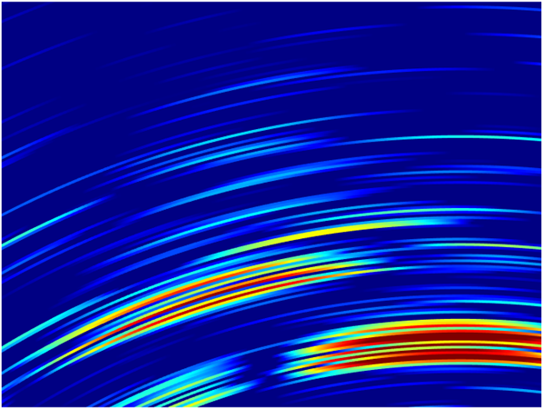
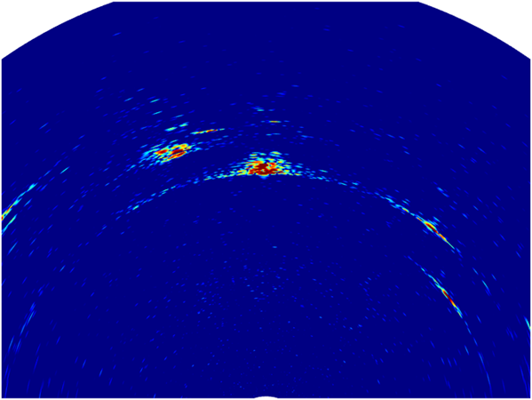
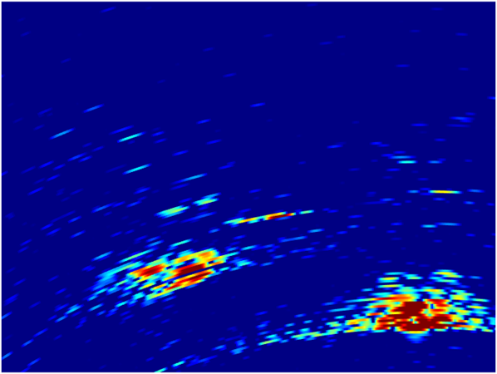
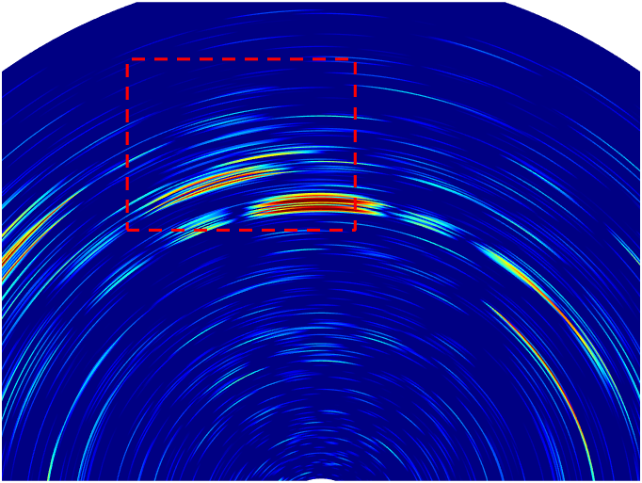
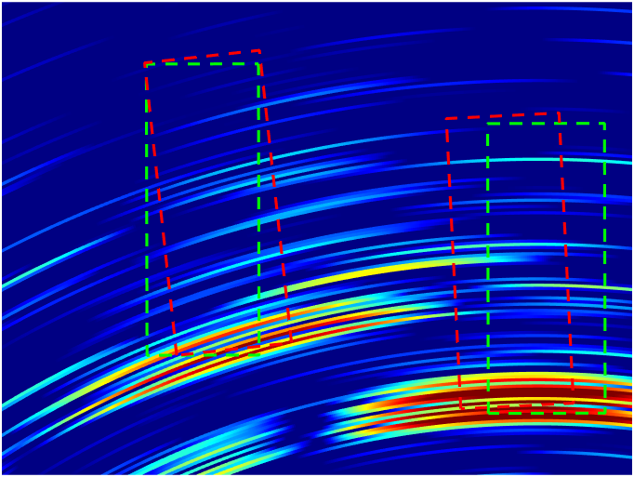
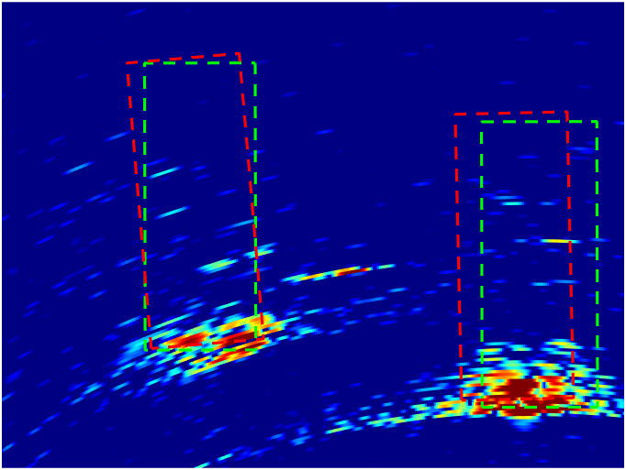
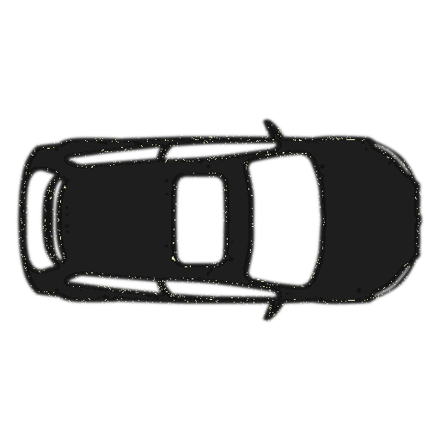
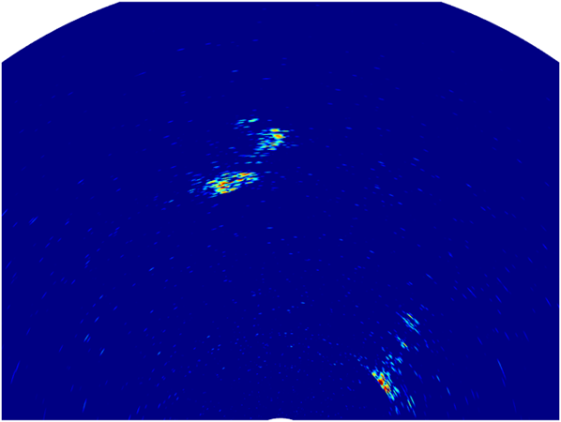
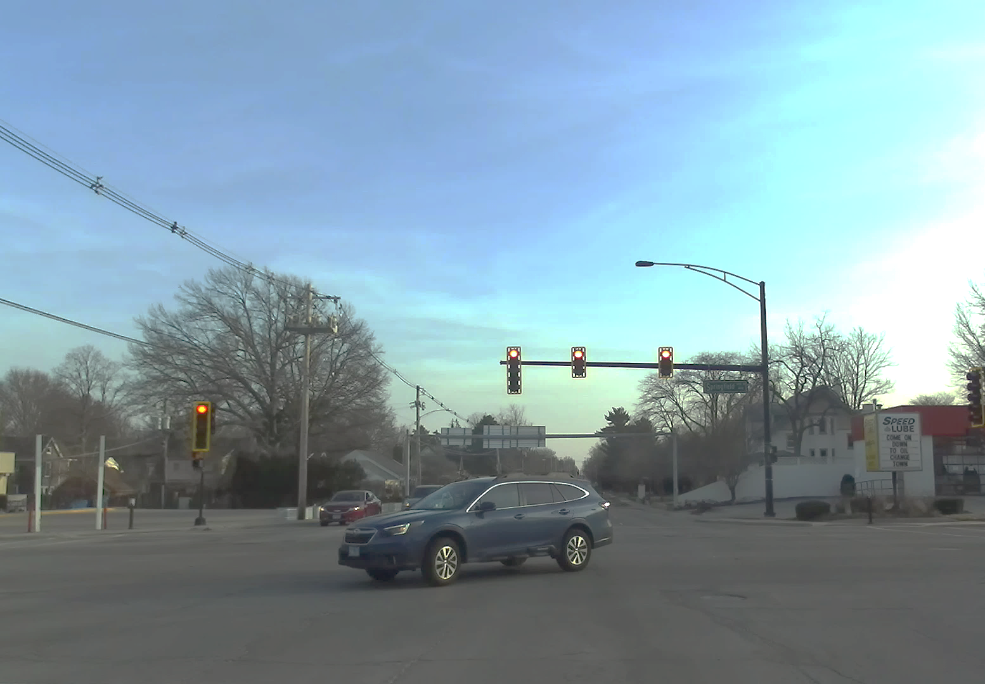
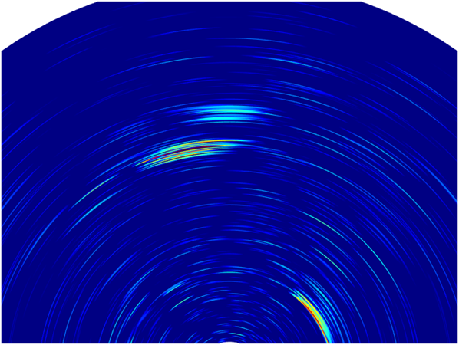
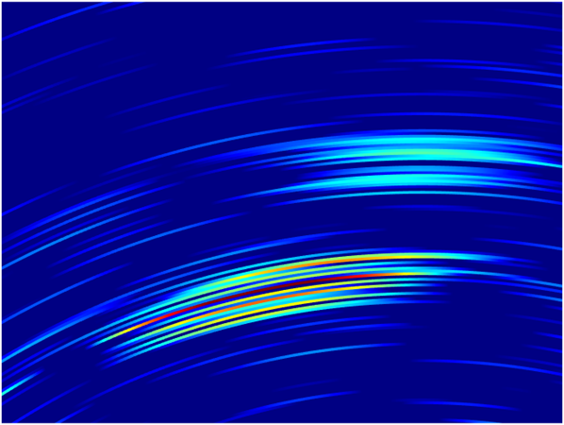
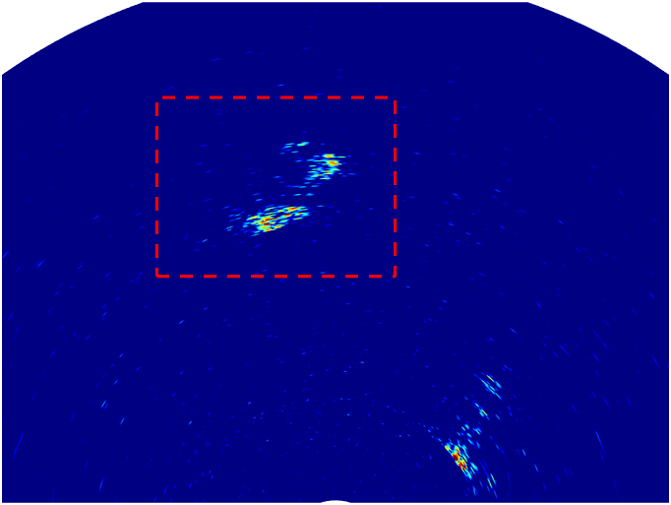
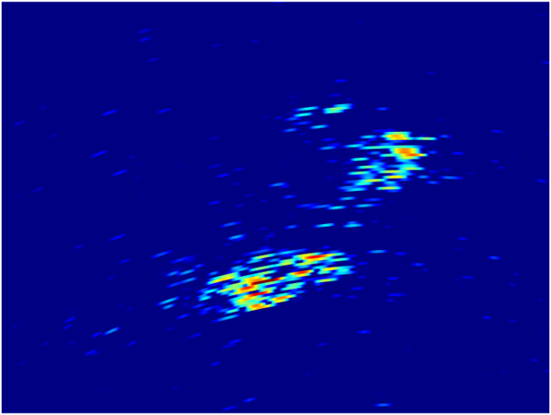
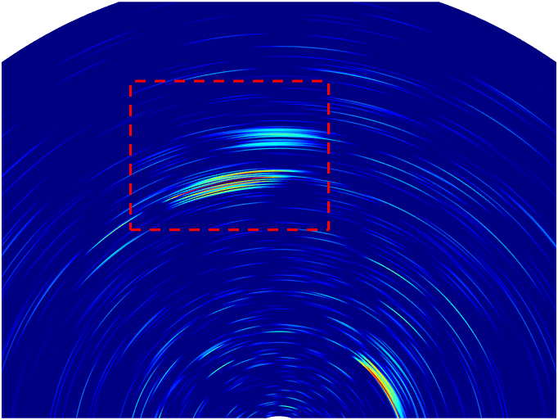
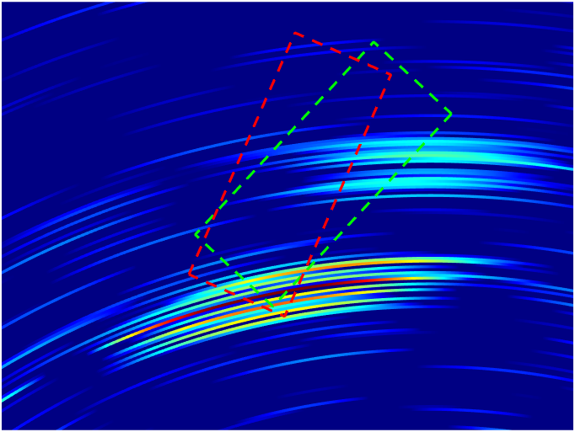
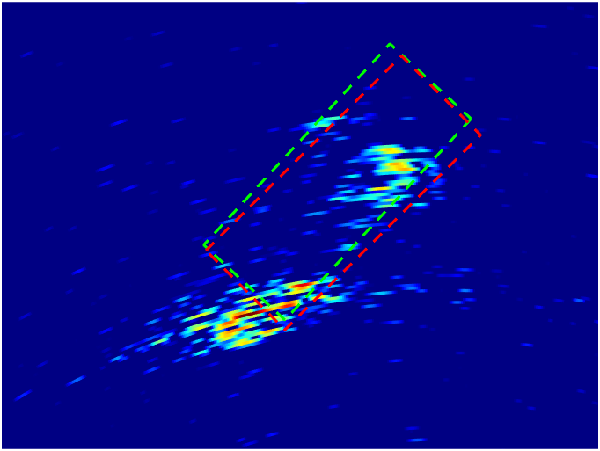
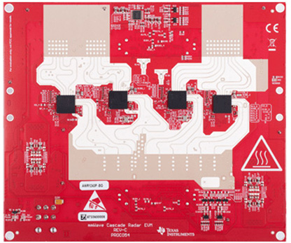
Scene
Low-Resolution Radar
Radatron++
Car silhouette: ground truth car location
Red: Predicted bounding box
Low angular resolution hinders
semantic scene understanding!
Low-Resolution
Single Chip Radar
Cascaded MIMO Radar

Slide 4
Imaging Radar Background
Tx Antenna
Rx Array
Radar Data Cube
$$φ$$
$$φ$$
$$d\sin\left(φ\right)$$
Antenna Space
Fast Time
(Samples)
$$d$$
i-th
j-th Rx antennas
Slow Time (Chirps)
Phase difference of the i-th and j-th Rx antennas
$$=\frac{2π}{λ}d\left(j−i\right)sin⁡φ$$
$$φ$$

Slide 5
Doppler Velocity Estimation
Antenna Space
Fast Time
(Samples)
$$k$$
Slow Time (Chirps)
Phase variation in the k-th Tx frame due to Doppler phase shift
$$=\frac{4π}{λ}vkT$$
$$v$$

Slide 6
MIMO Radar
Antenna Space
Tx Array
Fast Time
(Samples)
Emulated High-Resolution
Virtual Antenna Array
Slow Time (Chirps)
Rx Array

Slide 7
Transmitter
12 elements
Receiver
16 elements
Virtual Antenna Array
192 virtual elements
Cascaded MIMO Radar
1.8º Azimuth Resolution
10x higher than single-chip radars
Notes:
86+16*3 = 86+48 = 134

Slide 8
Transmitter
Time-Division Multiplexed
Receiver
Azimuth Position (Virtual Antenna)
Transmission time (kT)
High-resolution 86x1 virtual array emulated using 9 TX antennas

Slide 9
Challenges
Doppler Phase Shift Entanglement ⇒ Heatmap Distortions
Low Frame Rate ⇒ Ambiguity in Doppler Velocity
More severe in highly dynamic scenes!
Radatron++
1. Jointly leveraging a variety of virtual antenna array topologies.
2. Hybrid radar signal processing and deep learning solution.
3. Accurate vehicle detection from raw radar heatmaps.

Slide 10
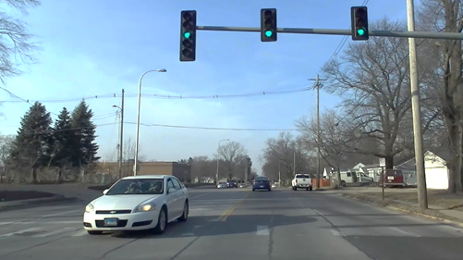
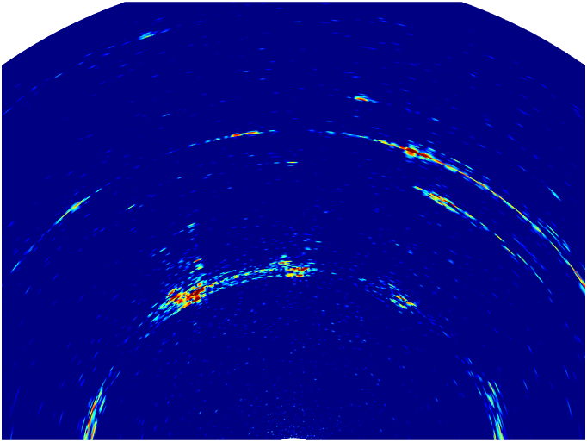
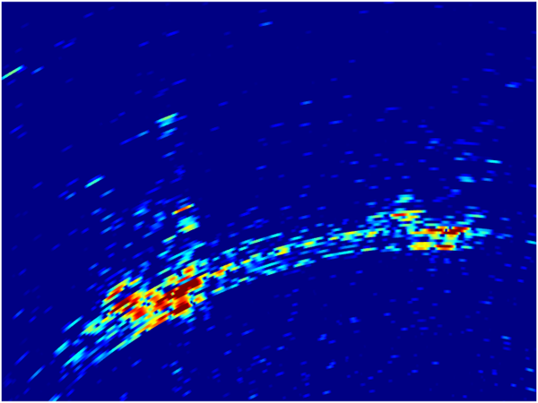
Challenge 1: Doppler Phase Entanglement
$$\text{Phase} \text{difference} \text{between} \text{virtual} \text{antenna} \text{links}\text{ (}\text{kTx}\text{, }\text{iRx}\text{), (}\text{lTx}\text{, }\text{jRx}\text{)}$$
$$=\frac{2π}{λ}[\underbrace{d\left(j−i\right)sin⁡φ}+\underbrace{d\left(l−k\right)sinφ}+\underbrace{2vT(l−k)}]$$
$$RX Antenna$$
$$Spatial Diversity$$
$$TX Antenna$$
$$Spatial Diversity$$
$$Doppler Shift$$

Slide 11
Doppler Phase Compensation Leveraging Redundancies
Co-located Virtual Antenna Pairs
Azimuth Position (Virtual Antenna)
TX 1
TX 2
TX 9
Transmission time (kT)
High-resolution 86x1 virtual array emulated using 9 TX antennas

Slide 12
Doppler Compensation Using Co-Located Virtual Antennas
Tx Array
Rx Array
$$φ$$
$$φ$$
$$d\sin\left(φ\right)$$
$$d\sin\left(φ\right)$$
$$d$$
$$d$$
(k-1)-th
k-th Tx antennas
i-th
(i+1)-th Rx antennas
Phase difference between co-located virtual antenna pairs (i,k) and (i+1,k-1)
$$=\frac{2π}{λ}\left[\underbrace{\left(i+1−i\right)dsinφ}+\underbrace{\left(k−1−k\right)dsinφ}+\underbrace{2vT\left(k−1−k\right)}\right]$$
$$=\frac{2π}{λ}∙\underbrace{2vT}$$
$$RX Spatial Diversity$$
$$TX Spatial Diversity$$
$$Doppler Shift$$
$$Doppler Shift$$

Slide 13
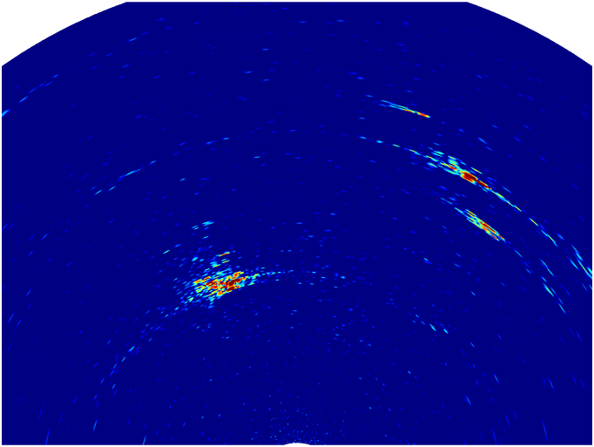
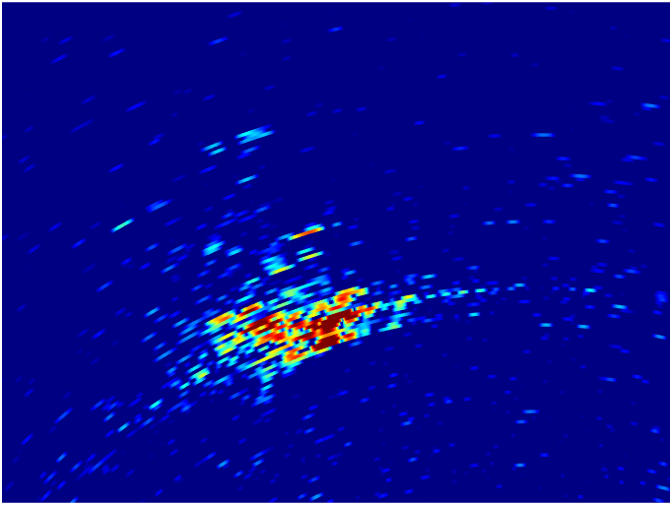
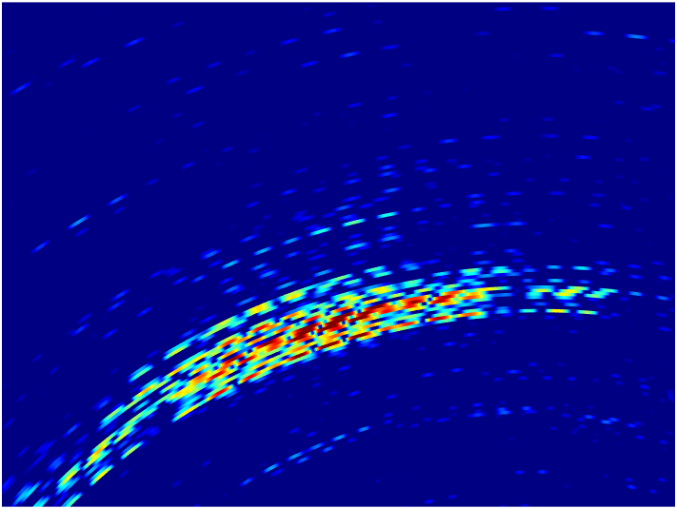
Residual Doppler Phase Entanglement
After Compensation
Single Transmitter
Jointly leverage the high- and low-resolution radar heatmaps.

Slide 14
Challenge 2: Ambiguity in Velocity Estimation
$$\text{Single}\text{−}\text{Tx} \text{Radar}$$
$k$-th and $k\text{+}1$-th chirps
Antenna Space
$$\frac{4π}{λ}∙vT\left(k+1−k\right)=\frac{4π}{λ}∙vT$$
Fast Time
(Samples)
Slow Time (Chirps)

Slide 15
Challenge 2: Ambiguity in Velocity Estimation
$$\text{Single}\text{−}\text{Tx} \text{Radar}$$
$k$-th and $k\text{+}1$-th chirps
$$\frac{4π}{λ}∙vT\left(k+1−k\right)=\frac{4π}{λ}∙vT$$
Antenna Space
$$\text{Cascaded} \text{MIMO} \text{Radar}$$
$k$-th and $k\text{+}12$-th chirps
TDM TX1
$$\frac{4π}{λ}∙vT\left(k+12−k\right)=\frac{4π}{λ}∙12vT$$
TDM TX2
Fast Time
(Samples)
12x lower maximum
unambiguous velocity!
TDM TX3
12 Chirp Intervals
TDM TX12
High-Resolution
Virtual Antenna Array
Slow Time (Chirps)

Slide 16
Low-Ambiguity Doppler Processing
Leverage all consecutive Tx chirps for Doppler estimation
Antenna Space
TDM TX1
12x Doppler sampling rate
TDM TX2
12x max unambiguous Doppler velocity
Fast Time
(Samples)
TDM TX3
12 Chirp Intervals
TDM TX12
Slow Time (Chirps)

Slide 17
Low-Ambiguity Doppler Processing
TX Spatial Diversity
$$=\frac{2π}{λ}\left[\underbrace{kdsinφ}+\underbrace{2vTk}\right]$$
Phase Difference between consecutive chirps
Antenna Space
$$TX Spatial Diversity$$
$$Doppler Shift$$
TDM TX1
TDM TX2
Fast Time
(Samples)
TDM TX3
12 Chirp Intervals
TDM TX12
Slow Time (Chirps)

Slide 18
Low-Ambiguity Doppler Processing
RX Array Beamforming using Single-TX Virtual Array
$$=\frac{2π}{λ}idsinφ$$
1. Rx Array Phase Diversity
2. For every Angle of Reflection $φ$, compute
TX steering vector $\frac{2π}{λ}kdsinφ$
Antenna Space
3. Multiplying with the complex conjugate
$$−\frac{2π}{λ}kdsinφ+\frac{2π}{λ}\left[kdsinφ+2vTk\right]$$
TDM TX1
TDM TX2
$$=\frac{4π}{λ}vT$$
Fast Time
(Samples)
TDM TX3
12 Chirp Intervals
TDM TX12
Slow Time (Chirps)

Slide 19
Low-Ambiguity Doppler Processing
$$=\frac{2π}{λ}idsinφ$$
1. Rx Array Phase Diversity
TDM TX1
TDM TX12
2. For every Angle of Reflection $φ$, compute
TX steering vector $\frac{2π}{λ}kdsinφ$
TDM TX2
TDM TX3
Antenna Space
3. Multiplying with the complex conjugate
$$−\frac{2π}{λ}kdsinφ+\frac{2π}{λ}\left[kdsinφ+2vTk\right]$$
Fast Time
(Samples)
$$=\frac{4π}{λ}vT$$
1 Chirp Interval
Slow Time (Chirps)
TX spatial diversity eliminated!

Slide 20
Signal Processing Pipeline of Radatron++
Raw Radar Cube
16x1
Single TX
Virtual Array
Beamforming
TX Spatial Diversity Compensation
Doppler FFT
Arg Max
Range FFT
16x1
Single TX
Virtual Array
Beamforming
Virtual Antenna Array Emulation
32 Co-located
Virtual Antenna Pairs
Doppler Phase Estimation
Low-Resolution
Single-TX
Range-Azimuth Heatmap
Low-Ambiguity
Doppler Index Map
86x1 Multi-TX Cascaded
Virtual Array
Doppler Phase Compensation
Beamforming
High-Resolution Cascaded
Range-Azimuth Heatmap
GRAINGER ENGINEERING

Slide 21
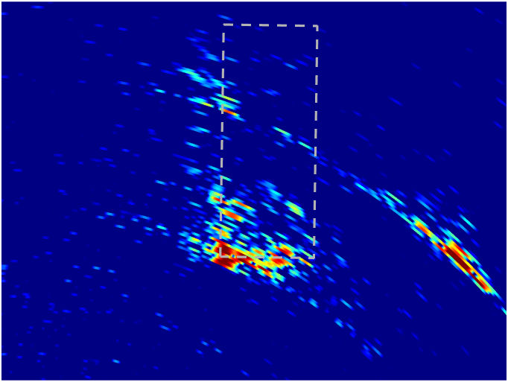
Network Architecture of Radatron++
96
384
768
512
Lateral Conv.
512
1024
2048
Low Resolution
Heatmap & Doppler Input
Stem
ResNet Stage
ResNet Stage
ResNet Stage
ResNet Stage
112$×$48
112$×$48
512
56$×$24
Lateral Conv.
56$×$24
Lateral Conv.
28$×$12
Lateral Conv.
14$×$6
448$×$192
Concatenate
64
256
ResNet Stage
256
256
z
256
Up Sample
z
256
Up Sample
z
Up Sample
High Resolution
Heatmap Input
Stem
ResNet Stage
28$×$12
14$×$6
56$×$24
3x3 Conv.
112$×$48
112$×$48
3x3 Conv.
448$×$192
112$×$48
3x3 Conv.
Radatron++’s
Two-Stream
FPN Backbone
3x3 Conv.
Polar2Cart
Polar2Cart
Polar2Cart
Polar2Cart
Output
zz
z
Rotated
Box Head
Region Proposal Network

Slide 22
Demo Video of Radatron++
No Temporal Post Processing
Frame to frame detection in the range of 25 meters.

Slide 23
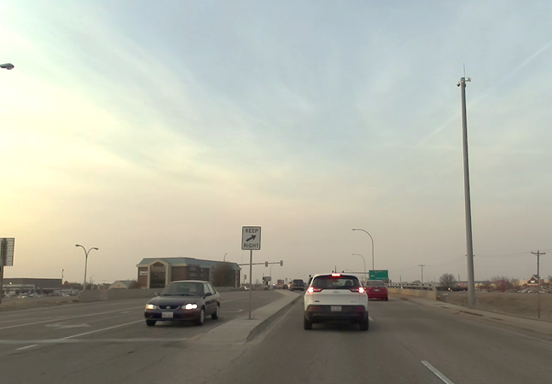
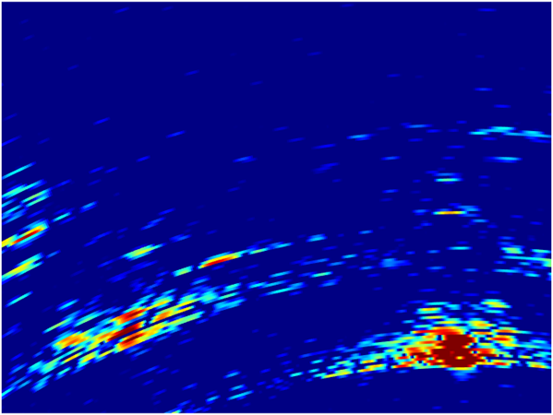
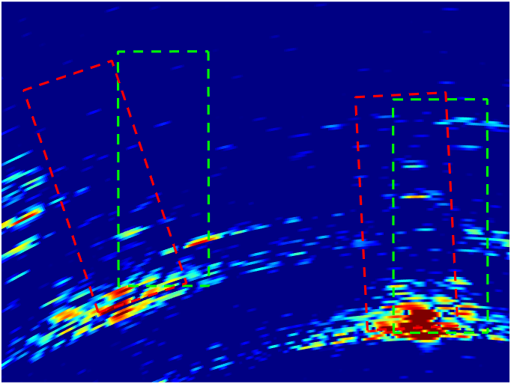
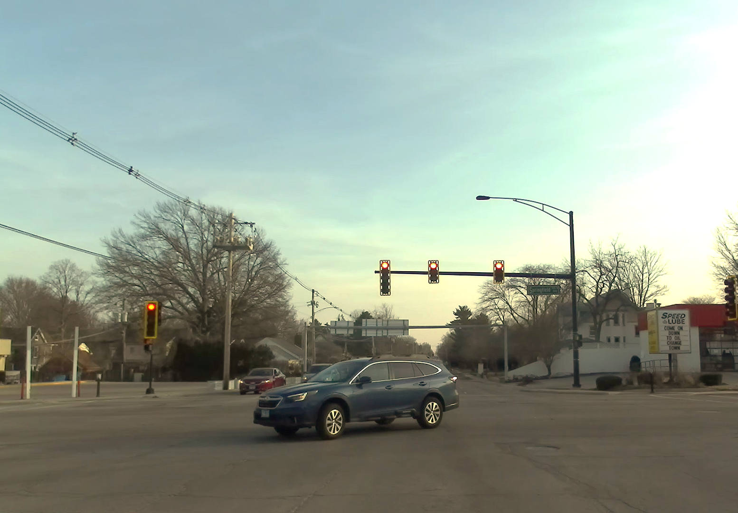
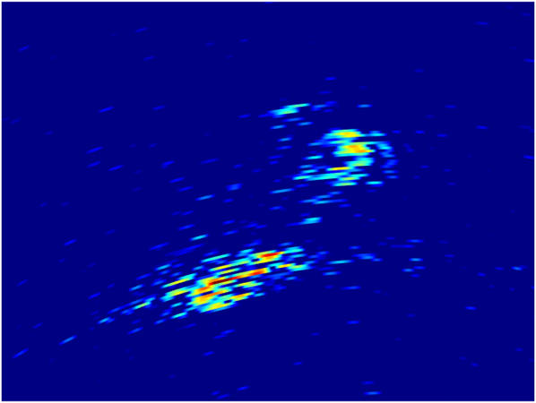
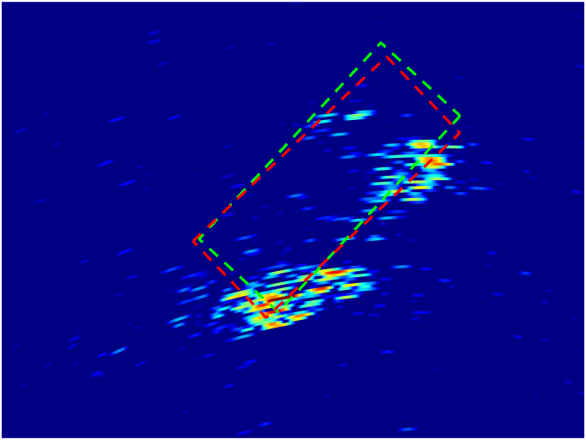
Radatron++ Conclusion
Cascaded
MIMO Radar
Low-Resolution Single-Chip Radar
High-Res. Cascaded Radar
Radatron
Car silhouette: ground truth car location
Dotted gray: Zoomed-in region of car
Dotted green circle: Ground truth reflections
Yellow circle: Smeared reflections
Red: Predicted bounding box
Jointly leveraging a variety of virtual antenna array topologies.
Hybrid radar signal processing and deep learning solution.
2D bounding box detection accuracy outperforms prior work using low-resolution radars by 9.3% (AP₅₀) and 18.1% (AP₇₅) respectively.
Radatron dataset is available on our website:
https://jguan.page/Radatron/

